Slide 1
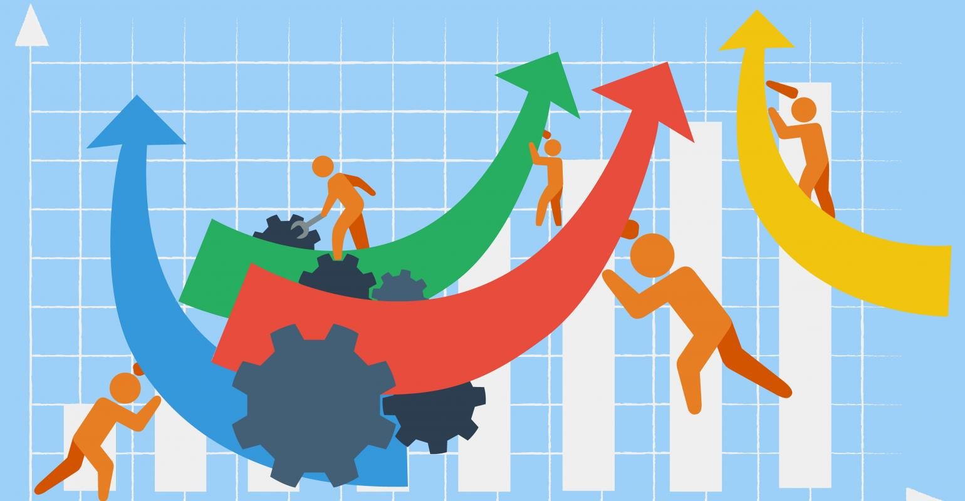
Overcoming Obstacles, Addressing Challenges – Agile Teams that Work
Eastern Iowa IIBA
September 21, 2016

Slide 2
Margaret Mead
Never doubt that a small group of thoughtful, committed people can change the world; indeed, it is the only thing that ever has.

Slide 3
Lessons Learned

Slide 4
Five Critical Steps in Forming Work Teams
Common purpose and shared performance goals
Define a working approach
Clarify roles and responsibilities
Establish team limits and boundaries
Create performance metrics

Slide 5
Five Dysfunctions of a Team Patrick Lencioni
Poor
Results
Avoidance of
Accountability
Lack of Commitment
Fear of Conflict
Absence of Trust

Slide 6
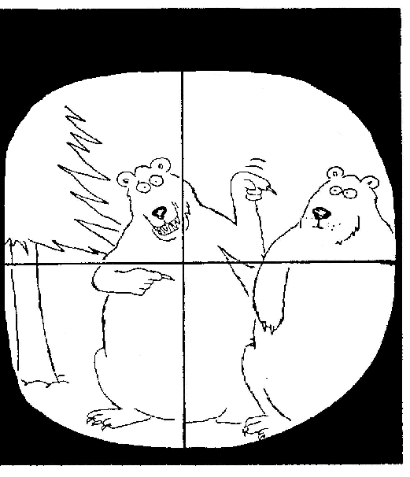

Slide 7
Ralph Waldo Trine
“Individuals carry their
success or failure with them.
It does not depend on outside conditions.”
If you had 0-100% on a scale, how much of your success and/or failure is due to your actions and behaviors and how much is up to outside conditions?

Slide 8
Language of Accountability
Victim Thinking (0%)
“Below the Line”
I inherited this group.
They don’t tell me anything.
I can’t…..
I’ll try…..
They should have….
When is that department….
10 years ago…..
This is a problem…
Change Agent (100%)
“Above the Line”
I accepted this role.
I don’t ask….
I am unwilling to….
I will….
I need to ….
What can I….
Today I must…
A solution might be.…

Slide 9
Below the Line® The Oz Principle by Connors, Smith and Hickman
You feel you lack control.
You find yourself blaming and point fingers.
You waste time and energy bashing your boss and colleagues.
You repeatedly find yourself in a defensive posture.
You are frequently sought out by others who like to gossip, spread rumors, and complain.
Discussions of problems focus more on what you cannot do rather than what you can do.

Slide 10
Above the Line®
You invite candid feedback about your performance.
You take ownership for your behaviors and results, good and bad.
You boldly face reality, including all its problems and challenges.
You don’t waste time and energy on things you cannot control or influence.
You ask “What else can I do to rise above my circumstance and get the results I want?”
You always commit yourself 100%.

Slide 11
Vulnerability Based Trust
Be vulnerable by sharing your weaknesses
Connect as people first
Keep your commitments
Take time to share and understand strengths and weaknesses
Expect the best and believe the best about the people you work with
Be loyal to your team members and customers-practice “tell me first”

Slide 12
Remember BEST!
B – Behavior
E – Effect
S – Solution
T – Take time

Slide 13
Developing an Outward Mindset
Mindset refers to the way people see and regard the world – how they see others, circumstances, challenges, opportunities and obligations.
Behaviors drive results. Mindset drives behaviors!
Inward vs. Outward
SAM

Slide 14
Six Basic Rules of Dialogue
Be open and suspend judgment.
Keep DIALOGUE and decision making separate.
Speak for yourself.
Listen with empathy and show you care.
Look for common ground.
Search for and disclose hidden assumptions, especially in yourself.

Slide 15
Remember BEST!
B – Behavior
E – Effect
S – Solution
T – Take time

Slide 16
Overcoming Resistance
What do people think they are losing?
SHIFT Model:
Surface
Honor
Indentify
Find
Thank
Accept the New Way
Communication
Training
Recognition
Perseverance and Positivity

Slide 17
